Slide 1
LSD - SLAM
2022.08.04
강경수

Slide 2
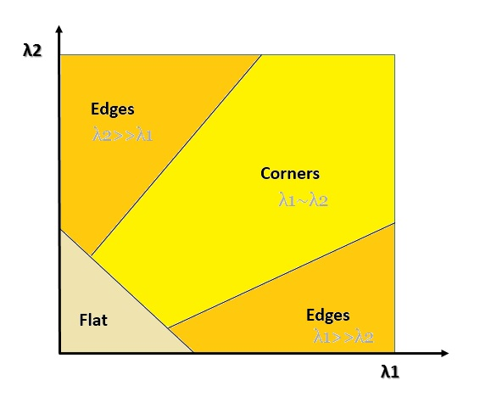
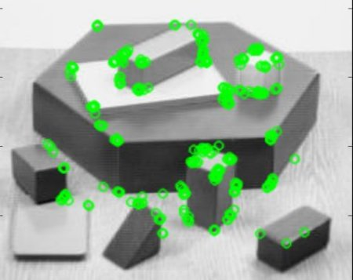
Topic – feature & direct
2 /
- Feature base Methods
1. Extract feature 2. computed position and mapping
using feature only
Using only feature can lose structural (edge) information in scene
Harris corner
Orb feature

Slide 3
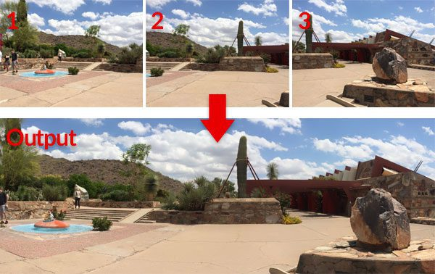
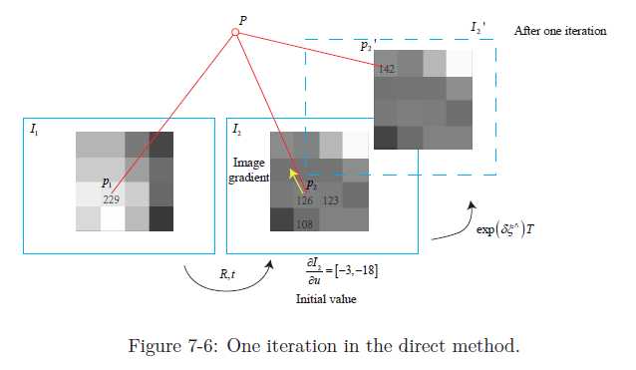
Topic – feature & direct
3 /
- direct method
computed position and mapping
using all information in the image
using structural(edge)
But, need parallel compute(GPU)
Image panorama, Assume that the illuminance does not change while the camera is moving

Slide 4
Motivation & contribute
4 /
- LSD
Direct method slam using Semi – Dense method
In real-time on CPU
Contribution (1). Direct monocular slam framework by semi-dense
- estimate similarity transform sim(3) between two keyframe
(2). Estimated depth into tracking
- probabilistically consistent incorporation of depth uncertainty

Slide 5
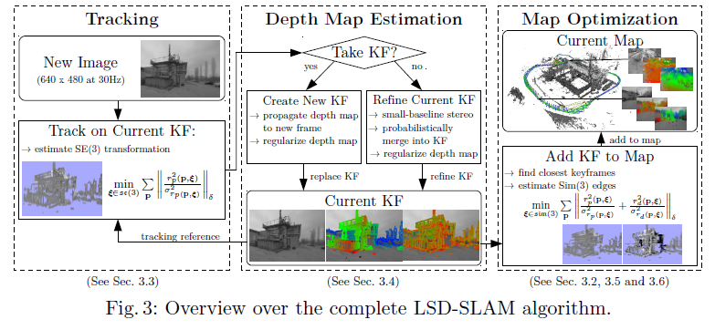
LSD-slam
5 /
- overview
Estimate pose se(3)
Estimate current KF depth
Estimate pose sim(3)

Slide 6
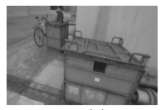
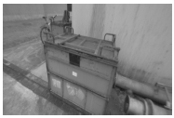
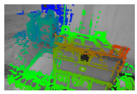
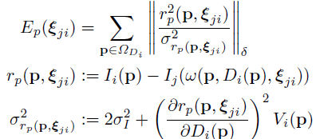
LSD-slam
6 /
- tracking
Previous frame
Current frame
se(3)
Previous frame depth (if init frame, random depth )
Unknown depth
Intensity residual
Depth variance
Intensity variance

Slide 7
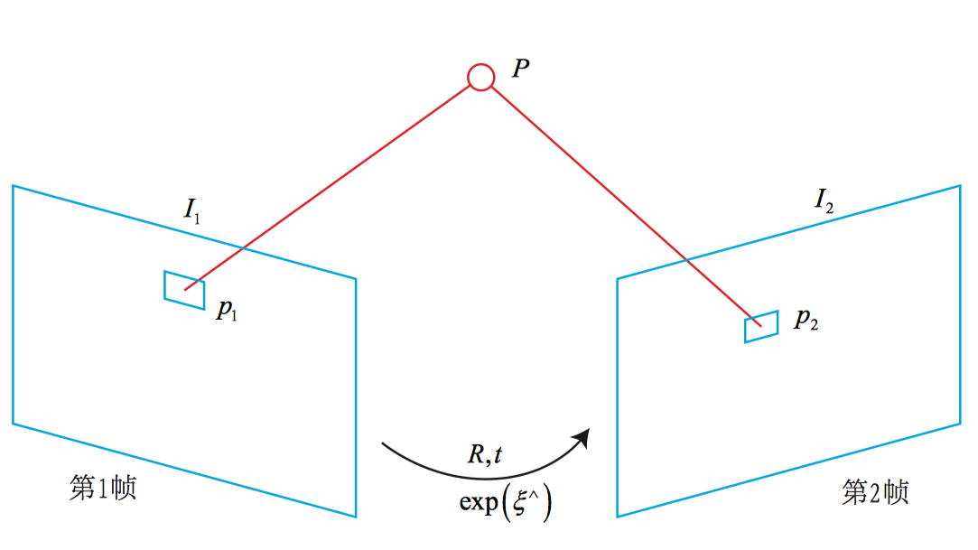



LSD-slam
7 /
- tracking
$$V_{i}$$
Depth uncertainty
$$σ_{I}$$
Intensity level uncertainty
$$σ_{I}$$
Previous frame
Current frame
Pure rotation no effect residual noise

Slide 8

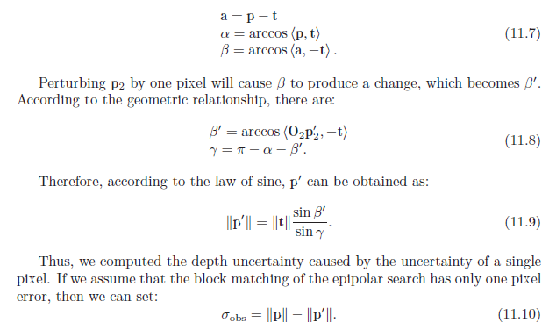
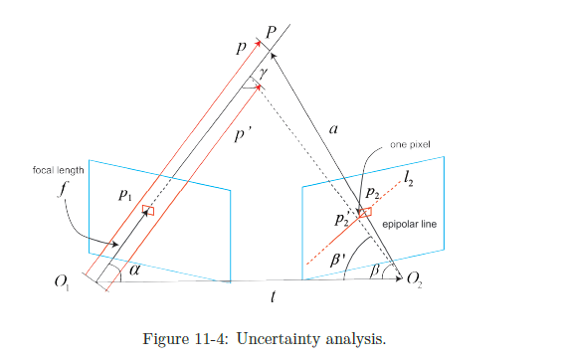
LSD-slam
8 /
- Depth map estimation
Insert KF & depth estimation current KF

Slide 9
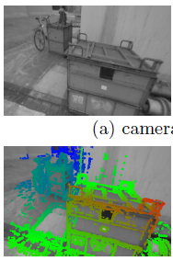
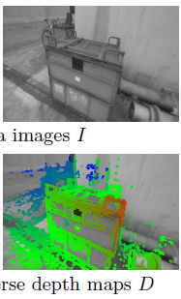


LSD-slam
9 /
- Estimate sim(3) KF
Remove scale drift
sim(3)

Slide 10




LSD-slam
10 /
- se(3) & sim(3)
Rigid body transform
$${ε=[x y z θ_{x} θ_{y} θ_{z}]}^{T} , ε∈se(3)$$
Rigid body transform + scale factor
$${ε=[x y z θ_{x} θ_{y} θ_{z} s]}^{T} , ε∈sim(3)$$

Slide 11
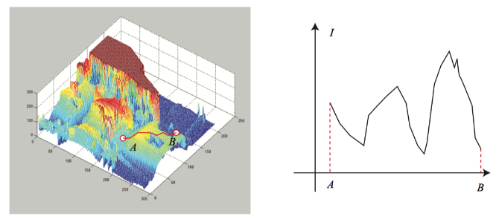
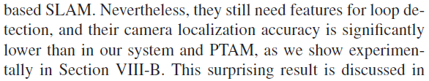
LSD-slam
11 /
- Loop closing
most similar of KF candidates
→ Direct method is hard to loop closing
: non-convexity
Visual slambook
Orb slam

Slide 12

LSD-slam
12 /
- map optimization
Graph optimization sim(3)

Slide 13
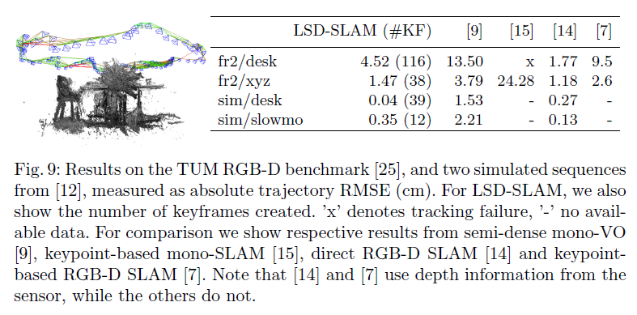
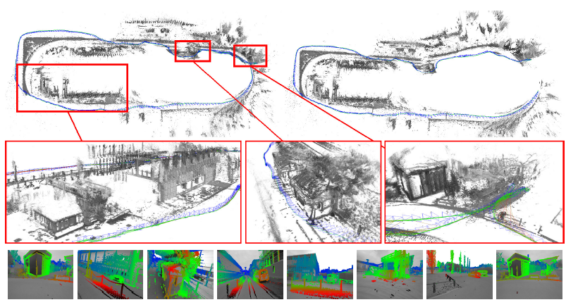
LSD-slam
13 /
- Experiment

Slide 14
Q & A.
14 /

